Slide 1
Introductory General Chemistry
Chemistry 3A
S. M. Halloran

Slide 2
This Slide Set: Book Chapter 4
Matter: Properties and Changes Affecting It
Compounds
Molecules As Polyatomic Forms of The Elements
Ionic Compounds
Chemistry Nomenclature: Naming of Compounds

Slide 3
Matter: Properties and Changes Affecting It
Physical Property
a characteristic of a substance that can be observed or measured without changing the identity of the substance
Color | Electrical conductivity
Hardness | Density
Malleability (ability to be hammered) | Melting point
Solubility | Boiling point

Slide 4
Matter: Properties and Changes Affecting It
Chemical Property
potential to undergo some chemical change or reaction by virtue of its composition
Metals like Zn (zinc) reacting with acid
Forming oxides in reacting with oxygen
This involves substance changing into another substance

Slide 5
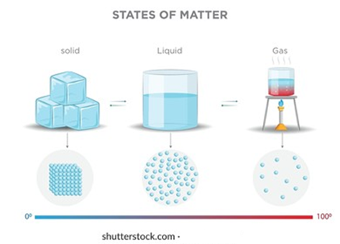
Physical (State) Changes
States of matter are solid, liquid, gas
Changes in the states of matters are:
Vaporization
Liquid to gas
Freezing
Liquid to solid
Condensation
Gas to liquid

Slide 6
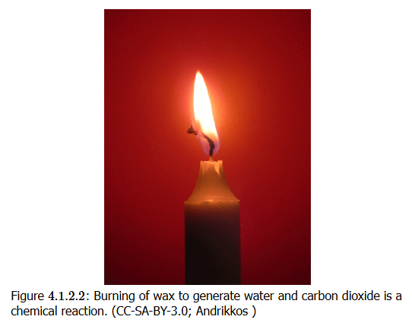
Chemical Changes

Slide 7
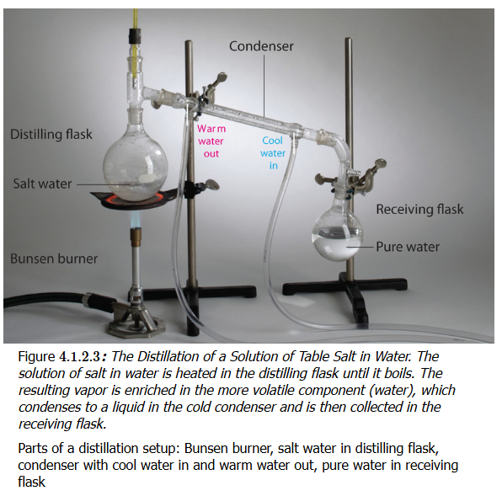
Making Use of Physical Properties
Distillation
Separating/purifying compounds based on boiling point
Precipitation
Separating/purifying compounds based on solubility
Some stay in solution,
Others come out of solution
Filtration
Separating compounds

Slide 8
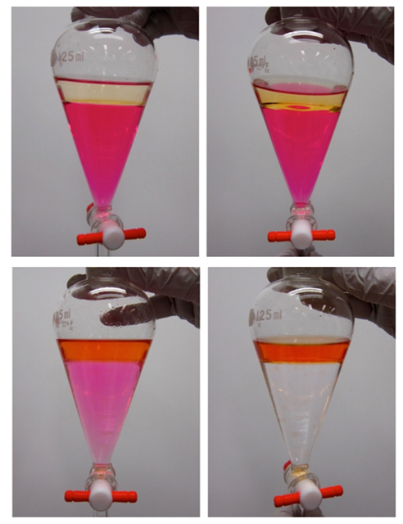
Making Use of Physical Properties
Solvent Extraction
Separating/purifying compounds based on preference (“partition”) for organic vs aqueous solvents
Chromatography
Separating/purifying compounds based on same principle as solvent extraction but with flowing (mobile) vs non-flowing (stationary) phases

Slide 9
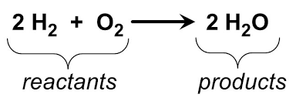
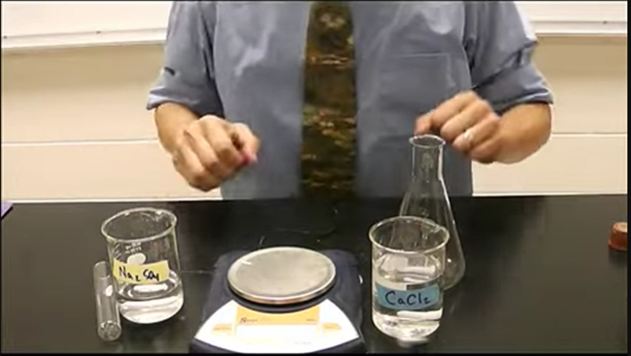
LAW of Conservation of Mass
1789 French chemist Lavoisier
Matter cannot be created or destroyed
Chemical reaction: mass of reactants and mass of products identical
https://www.youtube.com/watch?v=Wwmsy4huZQ0

Slide 10
Compounds
A compound is a substance that contains two or more elements chemically combined in a fixed proportion
CH4 (methane)
One carbon atom
Four hydrogen atoms
Unlike mixtures, cannot be separated by physical means
Can be “decomposed” by chemical changes CH₄ (g) + 2 O₂ (g) → CO₂ (g) + 2 H₂O (g)

Slide 11
Compounds: Chemical Formula
A chemical formula is a way of presenting information about the relative chemical proportions of atoms that constitute a particular compound or molecule
H₂O
H₂SO₄
Ca₃(PO₄)₂

Slide 12
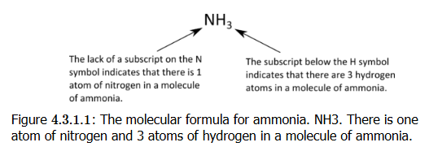
Compounds: Molecular Formula
A molecular formula is a chemical formula gives number of atoms of each of the elements present in one molecule of a specific compound
It is composed of element symbols for the atoms and subscripts to indicate count of the atoms. If there is only one atom in the compound, a subscripted “1” is omitted

Slide 13
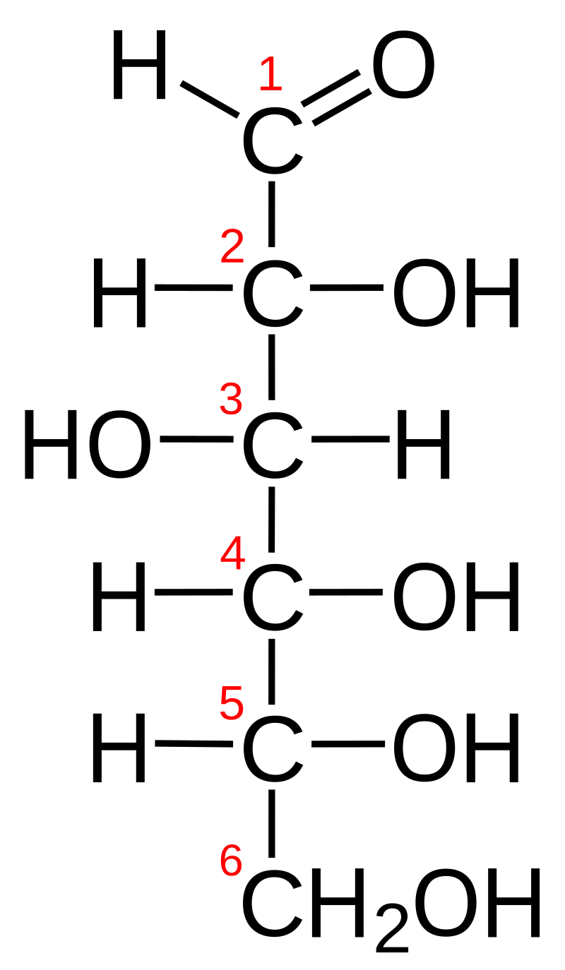
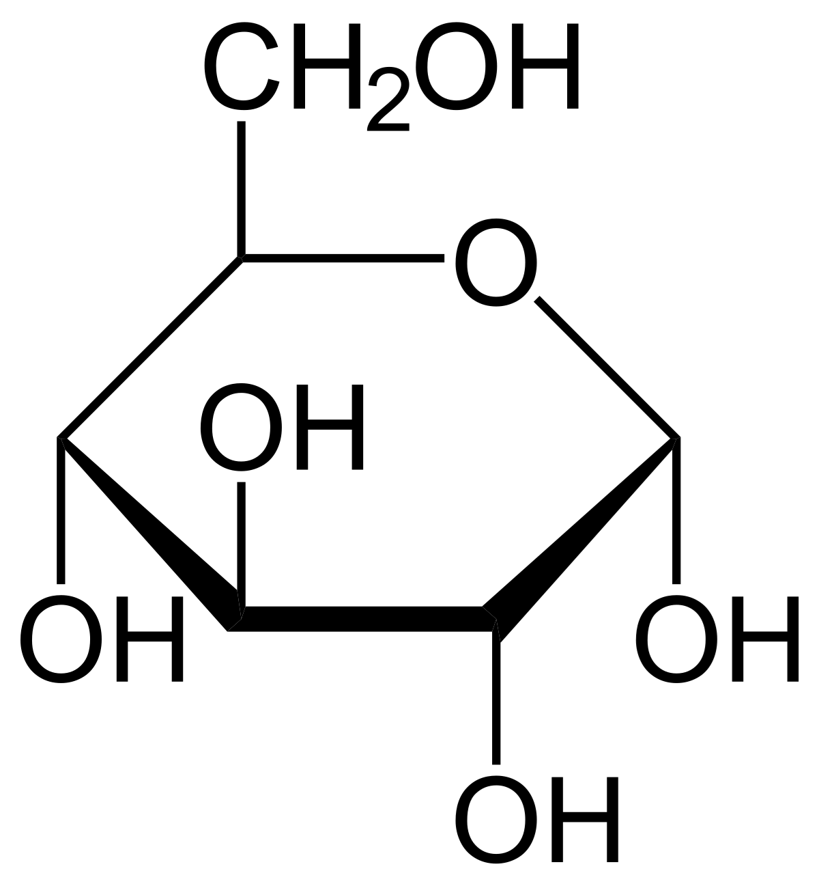
Compounds: Empirical Formula
An empirical formula is a chemical formula that shows the elements in a compound in their lowest whole-number ratio
Glucose has a molecular formula of C₆H₁₂O₆
But glucose has an empirical formula of CH₂O
Why? Because when chemists first start to analyze & characterize an unknown compound, they find glucose has 1 part carbon, 1 part oxygen, 2 parts hydrogen
NOTE THIS: in some cases the empirical formula and molecular formula are the same!!

Slide 14
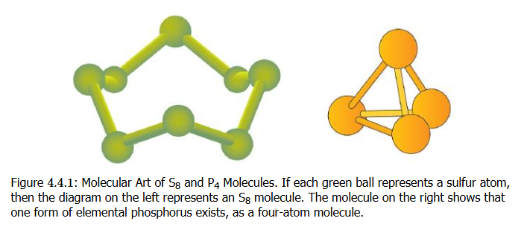
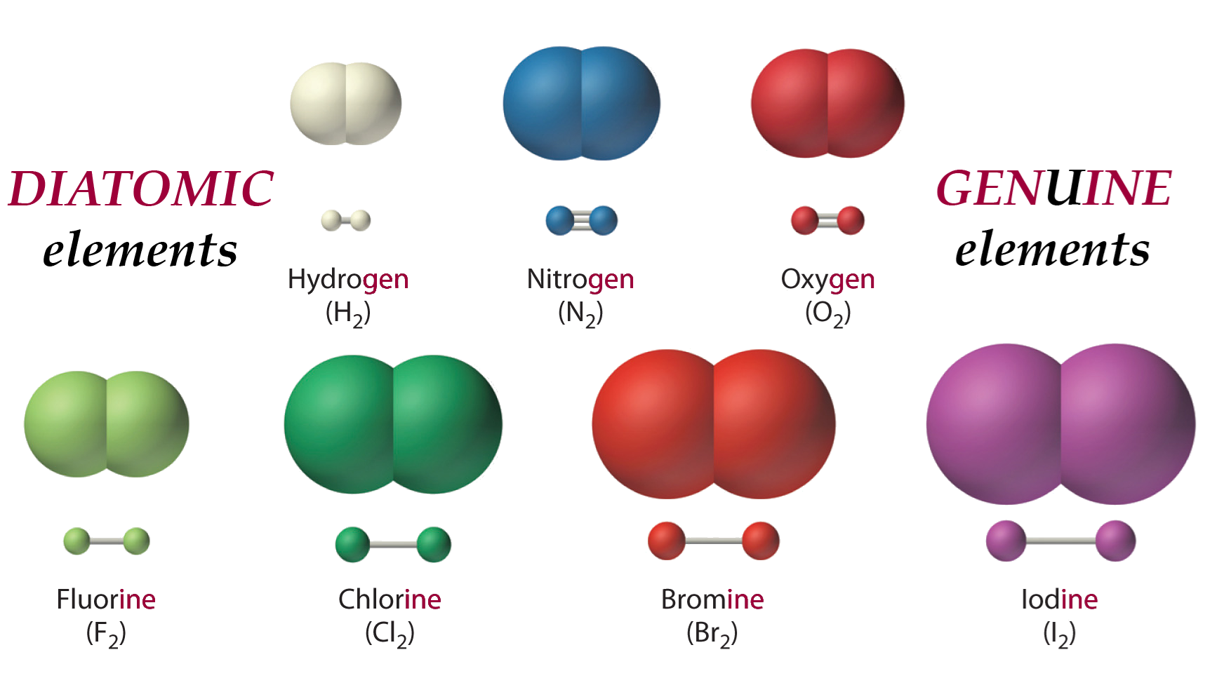
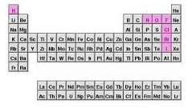
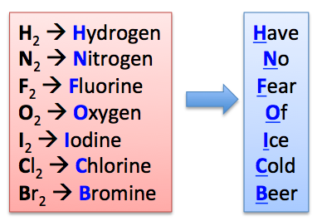
Atomic Elements, Molecular Elements
Elements that exist as their individual atoms in nature are called atomic elements
Some elements do not exist in nature as individual atoms, but bonded with each other. These are molecular elements
Molecular elements can form often diatomic molecules or polyatomic molecules

Slide 15
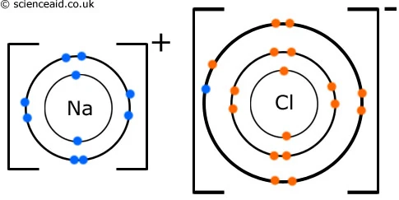
Ionic Compounds
Ionic compounds form when atoms BOND with each other based on one atom have a positive charge and the other having a negative charge
A sodium (Na) atom easily gives up the ONE electron (all for energetic stability) which is its ONE valence shell electron to a chlorine (Cl) atom which has SEVEN valence shell electrons and wants a more stable complete valence shell of EIGHT electrons. The electron transfer creates an IONIC bond and Na and Cl will form an ionic compound as a result

Slide 16
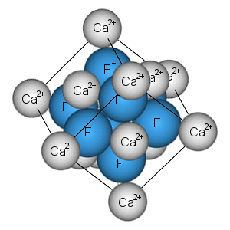
Ionic Compounds
Generally metal elements will form ionic compounds with nonmetal elements in the correct ratios
Metals will give up electrons and nonmetals as a rule to form these ionic compounds (with lots of exceptions to the rule)

Slide 17
Formula Unit
“The formula unit is the basic unit of ionic compounds”
Also: “in chemistry, a formula unit is the smallest unit of a non-molecular substance, such as an ionic compound, covalent network solid, or metal
Something that does form a discrete molecule, something not forming a molecular compound
NaCl, CaF₂, ZnBr₂ are the three formula units of these ionic compounds

Slide 18


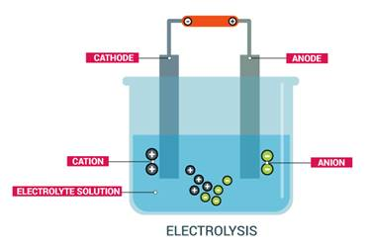
Cations and Anions
We talked about this is a previous lecture
cations “move to” the cathode
anions “move to” the anode
Cations are positively charged ions
Na⁺, K⁺, Ca²⁺, Li⁺
Anions are negatively charged ions
Cl⁻, Br⁻, OH⁻
Cathode is negatively charged pole
Anode is positively charged pole

Slide 19
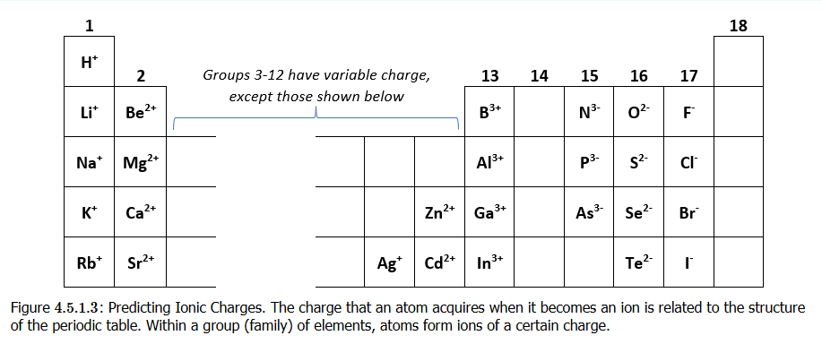
Table group and number of electrons in valence shell are connected

Slide 20
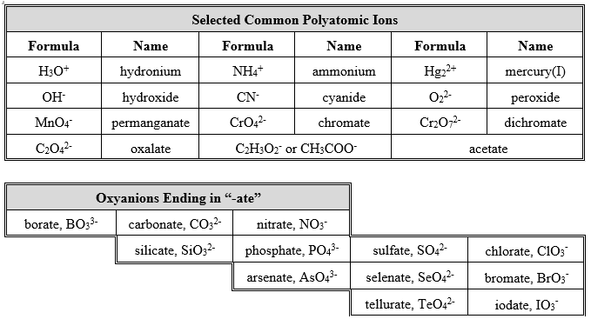
Polyatomic Ions

Slide 21
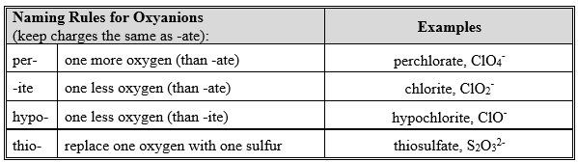
Naming Oxyanions

Slide 22
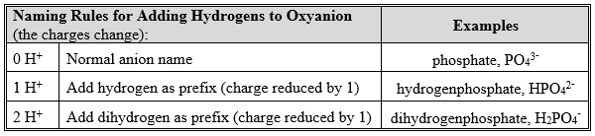
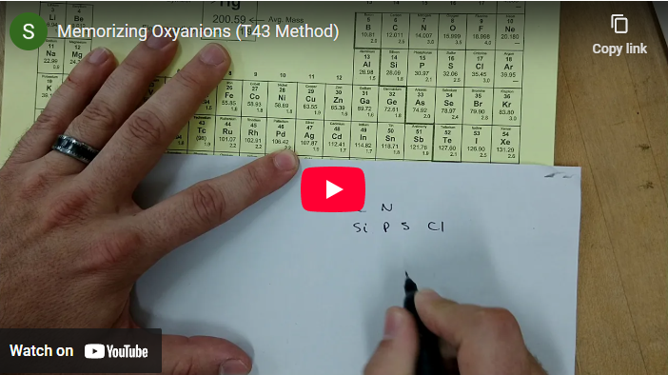
Naming Oxyanions
https://youtu.be/ijSk_7ukv10

Slide 23
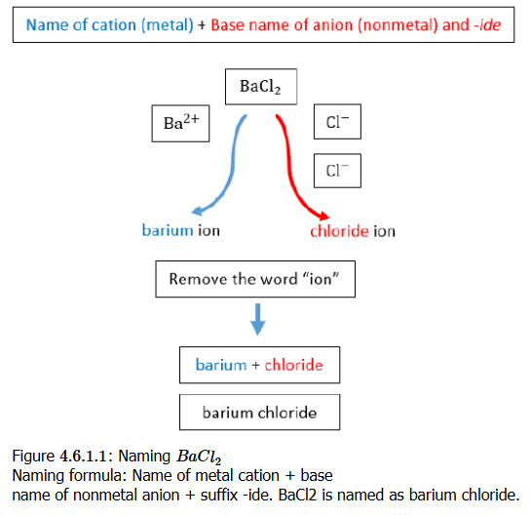
Chemistry Nomenclature: Naming of Compounds

Slide 24
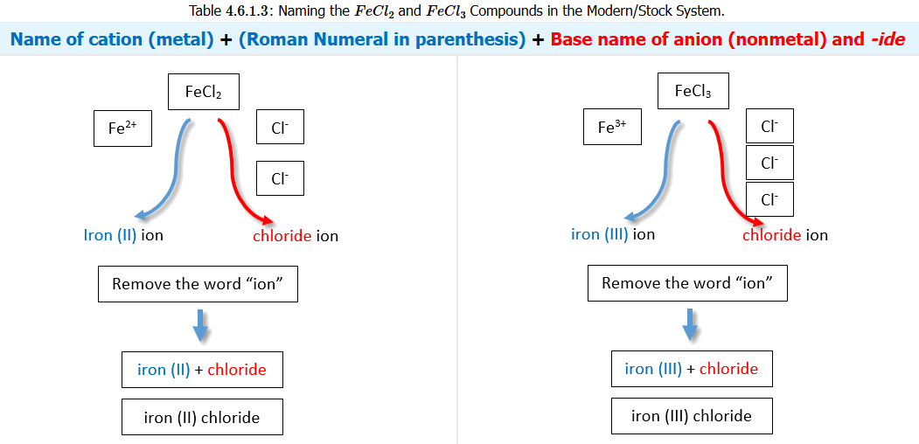
Chemistry Nomenclature: Naming of Compounds

Slide 25
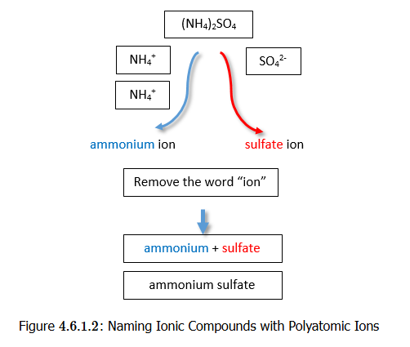
Chemistry Nomenclature: Naming of Compounds

Slide 26
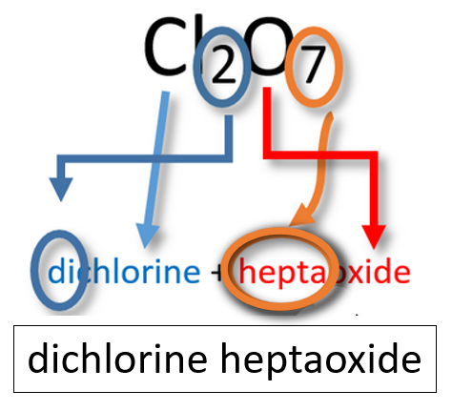
Molecular Compound Naming
Binary Molecular Compounds
Simple (common) molecules

Slide 27
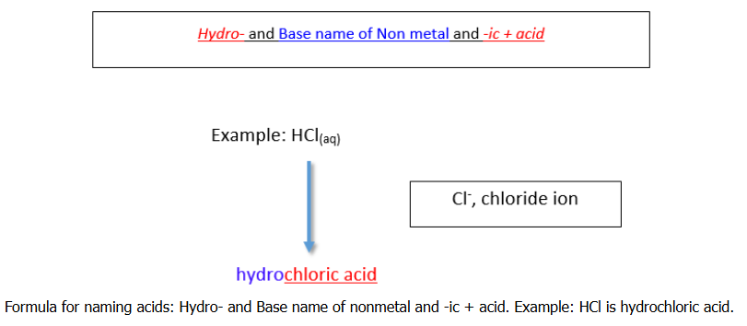
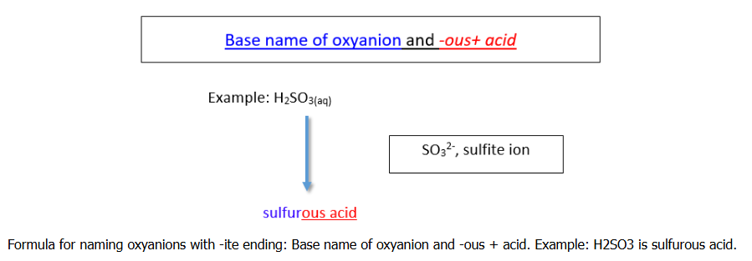
Molecular Compound Naming
Acids
Naming Binary Acids
Naming Oxyacids

Slide 28
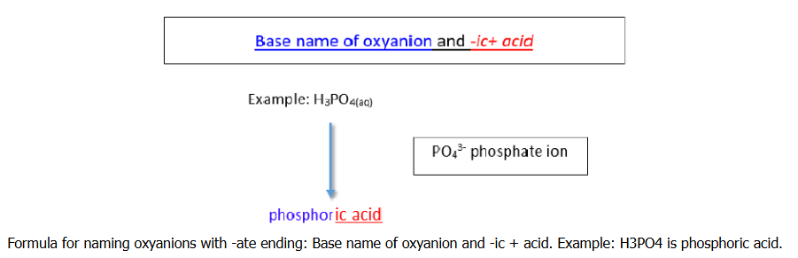
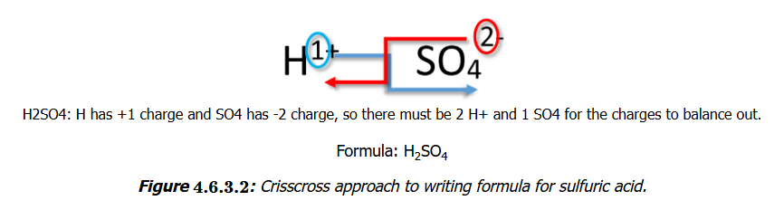
Molecular Compound Naming
Acids
Naming Binary Acids
Naming Oxyacids

Slide 29
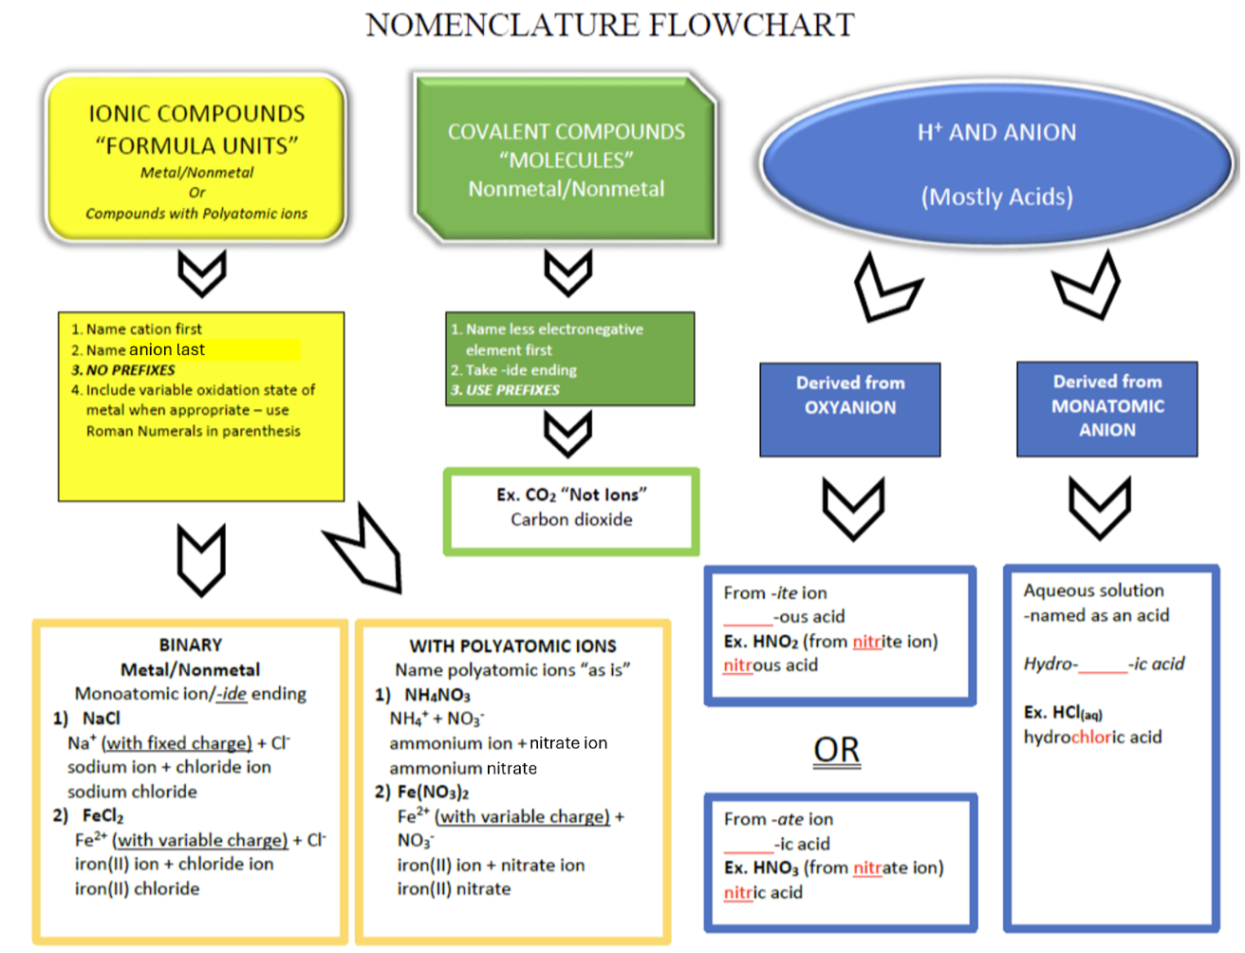
Tying It Together

Slide 30
Introduction to Matter

